Slide 1
Marketing and Retail Analytics Build a Marketing Mix Model
Anshuman Dash

Slide 2
Business Understanding
Business Objective
To build a marketing mix model for the Sales Media
Expected Outcome
Develop a Marketing Mix Model (Koyck Model) by identifying suitable lag for the dependent and independent variables
Identify current effect & evaluate carryover effect
Determine the total effect of advertising
Determine a suitable curve to trace the effect of advertising on sales

Slide 3
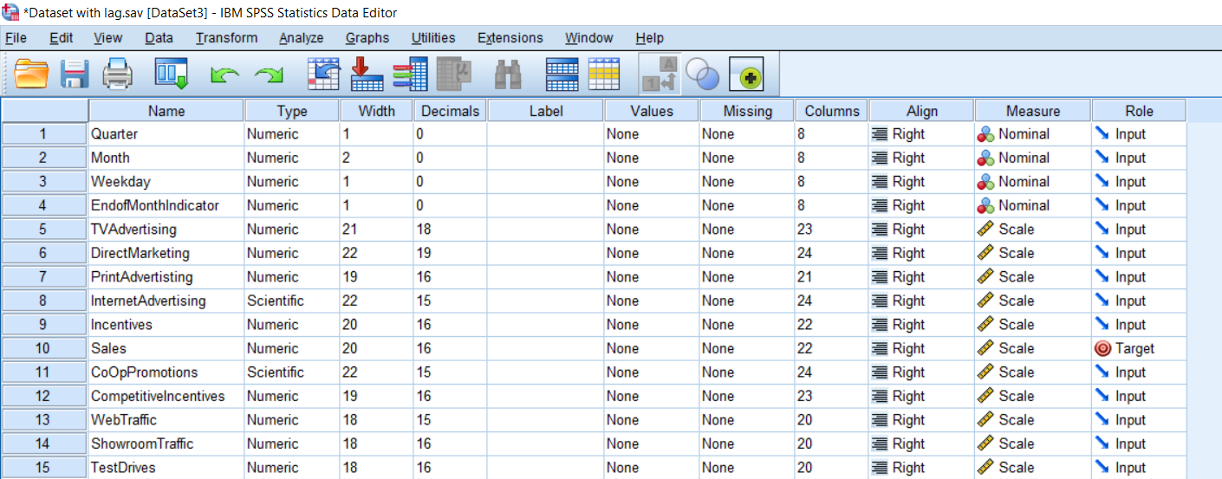
Data Understanding
Data set - Sales Media Data
There are 15 variables and 16801 rows
Variable headers - Quarter, Month, Weekday, End of Month Indicator, TV Advertising, Direct Marketing, Print Advertising, Internet Advertising, Incentives, Sales, Co-Op Promotions, Competitive Incentives, Web Traffic, Showroom Traffic, Test Drives
Variable Details and Variable Types as seen in SPSS

Slide 4
Data Preparation
Missing Value Treatment
Following columns have missing values
Sales, Competitive Incentives, Web Traffic, Showroom Traffic & Test Drives
Replaced missing cells with the “Mean” values
Variable Selection
Based on the Correlation Matrix, variables with > 0.3 correlation with the ‘Sales’ variable were selected (for model building

Slide 5
Modeling
The following Models were built with the selected variables
Stepwise Linear Regression
Forward Regression
Backward Regression

Slide 6
Modeling
Stepwise | Backward | Forward
Variables included : (Constant), WebTraffic, DIFF(Sales,1), TVAdvertising, Incentives, DIFF(Sales,2), InternetAdvertising, ShowroomTraffic, CoOpPromotions, DIFF(Sales,3), DIFF(CompetitiveIncentives,1), DIFF(ShowroomTraffic,1), TestDrives, DIFF(TestDrives,1), DIFF(Incentives,1), DIFF(WebTraffic,1) | Variables included: (Constant), DIFF(TestDrives,1), TVAdvertising, DIFF(CompetitiveIncentives,1), Incentives, CoOpPromotions, DIFF(Sales,3), InternetAdvertising, DIFF(Incentives,1), DIFF(WebTraffic,1), TestDrives, WebTraffic, DIFF(Sales,1), DIFF(ShowroomTraffic,1), DIFF(Sales,2), ShowroomTraffic | Variables included: (Constant), WebTraffic, DIFF(Sales,1), TVAdvertising, Incentives, DIFF(Sales,2), InternetAdvertising, ShowroomTraffic, CoOpPromotions, DIFF(Sales,3), DIFF(CompetitiveIncentives,1), DIFF(ShowroomTraffic,1), TestDrives, DIFF(TestDrives,1), DIFF(Incentives,1), DIFF(WebTraffic,1)
The variables across all the 3 models are the same.
These are taken further for analysis

Slide 7
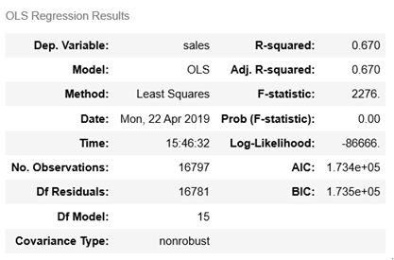
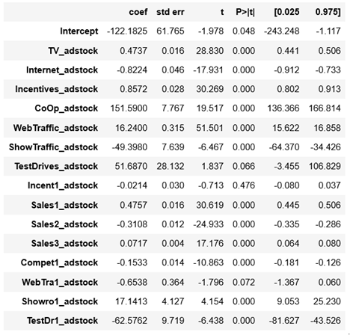
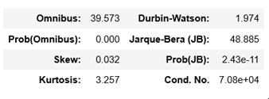
Modeling
Regression Model with Adstock Variables

Slide 8
Codes on GitHub
Profile GitHub is available under anshumandash/MyAnalyticsWorld
https://github.com/anshumandash/MyAnalyticsWorld/blob/master/MMM%20Adstock.html

Slide 9

Thank You

